Slide 1



Slide 2

What Do We Love About Gaming?
Gaming is fun!
Friends
Teamwork
Problem solving
But we all need balance

Slide 3
Meet Alan….
Alan keeps on saying “Just one more game…..”
Soon, it’s very late

Slide 4
What happens after a late night?
Tired at school
Hard to concentrate
Forgetful
Low energy
You might get irritable

Slide 5
When gaming starts to take over…
• Thinking about the game all the time
• Hard to stop
• Feeling cross when asked to stop
• Dependency can grow

Slide 6
Why parents set limits
Parents set limits because they care. They want you to be healthy and happy and ready to learn at school.

Slide 7
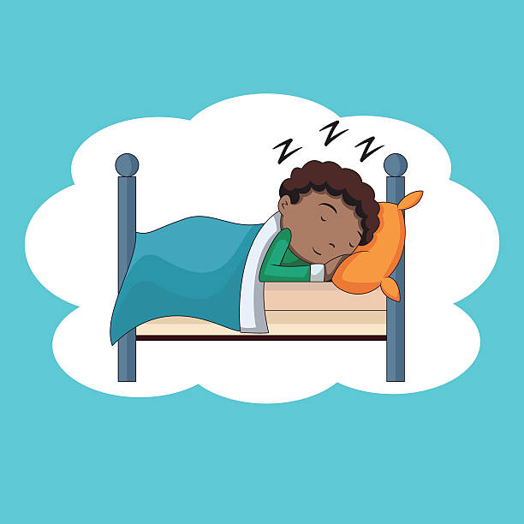
Why sleep matters
9–12 hours of sleep helps:
• Learning
• Growing
• Memory
• Mood

Slide 8

Be the Boss of your gaming
• Set a finish time
• Use a timer
• No screens before bed
• Read, chat or play instead

Slide 9
What small change could you make this week?

Slide 10
Challenge
When you switch OFF your screen, you switch ON:
❤️ Sleep
🧠 Learning
😊 Happiness
👨‍👩‍👧 Family Time

Slide 11
You are the boss of your technology, not the other way around!

Slide 12


