Slide 1
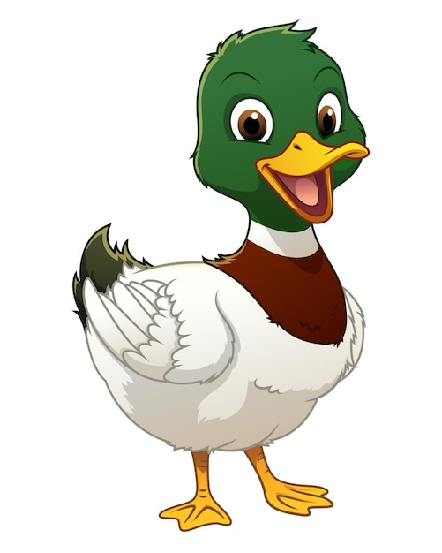
What are British Values?

Slide 2


Slide 3

Respect for different faiths and beliefs
What does this mean?

Slide 4
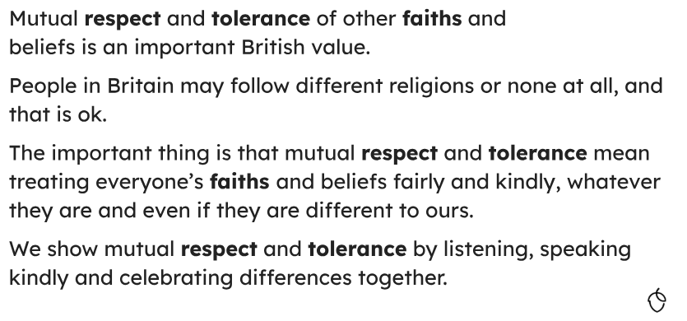

Slide 5
Respect for different faiths and beliefs
In R.E. lessons, we learn about different faiths and beliefs. We go to different places of worship to learn about different cultures:
Synagogue, Mandir temple, Mosque, Gudwara.

Slide 6
Respect for different faiths and beliefs
During Equalities Week, we learn to respect our differences and embrace diversity.

Slide 7
Respect for different faiths and beliefs
On VIP Day, we invite parents or other family members in to share their jobs or beliefs.

Slide 8

Learning about everybody’s differences is very important. We’re not the same, we don’t always believe the same, and that’s OK. We listen and respect everyone.
This makes us a caring, trusting and respectful community.

