Slide 1
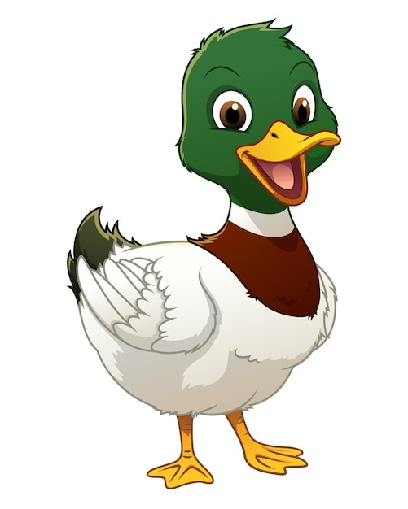
What are British Values?

Slide 2


Slide 3

Individual Liberty
What does this mean?

Slide 4
Liberty
liber comes from the Latin root word “liber” and means “free”

Slide 5
Individual Liberty
The freedom to believe, speak and express yourself without hurting others (and within the law)

Slide 6
What choices do you make every day?

Slide 7
What game to play at lunchtimes
Who to play with
What to eat for lunch
What book to read at bedtimes
What to wear at weekends
What sport’s team to support
Which clubs to attend at school

Slide 8
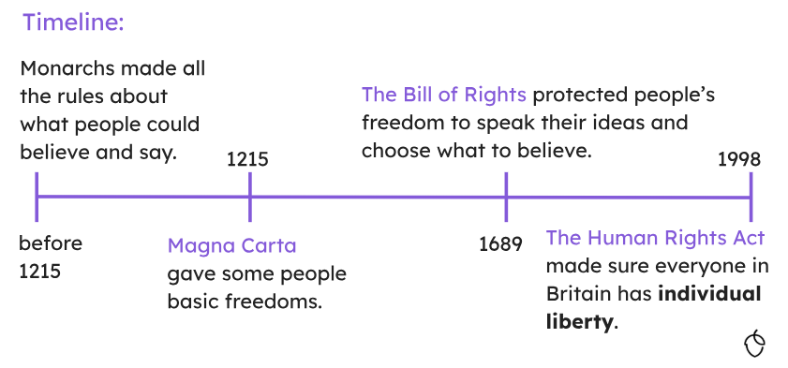
Your individual liberty has been fought for throughout history and is now protected

Slide 9
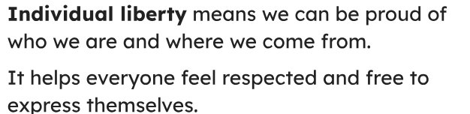

Slide 10
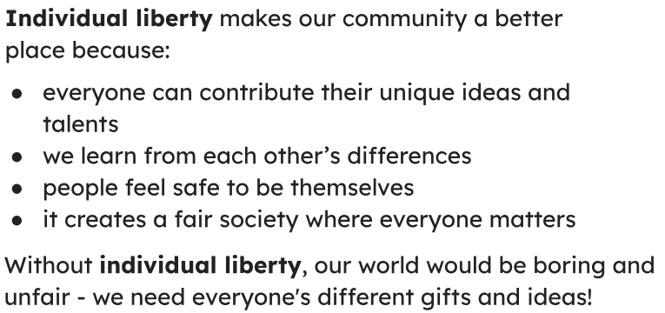

Slide 11
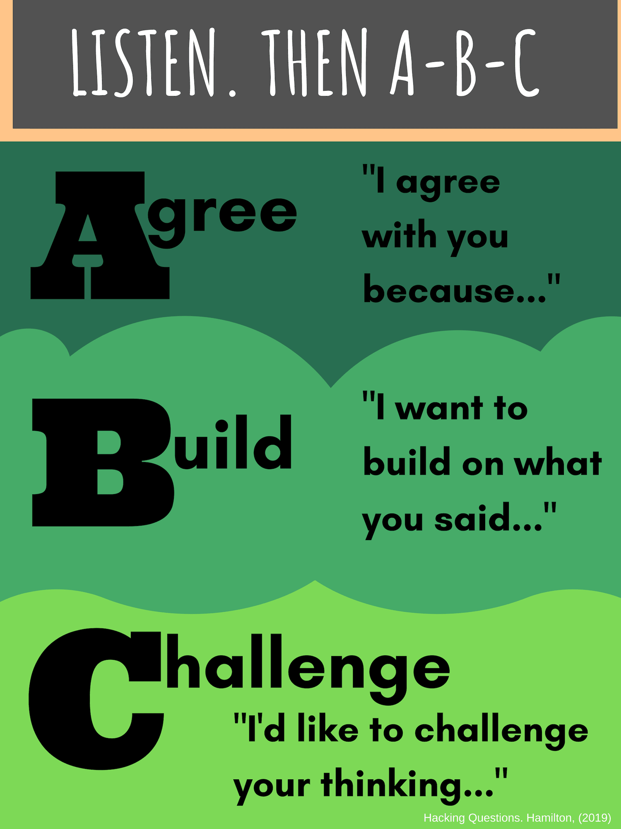
We can use our individual liberty to express our opinions, but we must remember to be kind to each other. That’s why we use our Agree, Build, Challenge in class for discussions.

Slide 12
We can use our individual liberty to express our opinions, but we must remember to be respectful to each other. That’s why we use teach you to be safe online and about different faiths and beliefs.

Slide 13

We can use our individual liberty to choose what we spend our free time doing, but we should balance that with taking responsibility and keeping ourselves healthy and safe. That’s why we have Disconnect to Reconnect Weeks.

Slide 14


