Slide 1
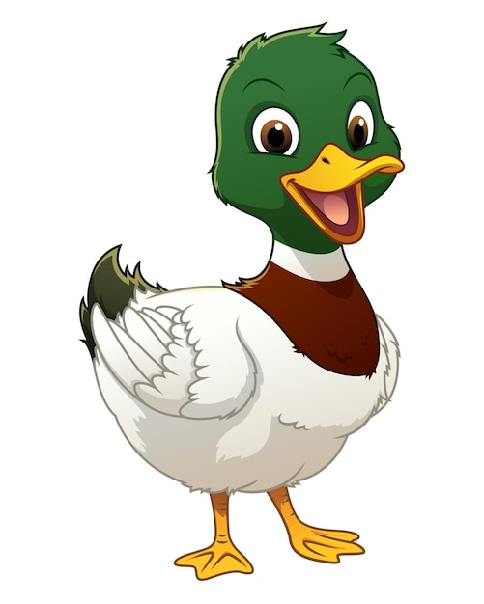
What are British Values?

Slide 2


Slide 3

The Rule of Law
What does this mean?

Slide 4
The Rule of Law
Rule of Law means everyone is equal before the law, and laws are in place to keep us safe.

Slide 5
Who makes the rules for our country?

Slide 6
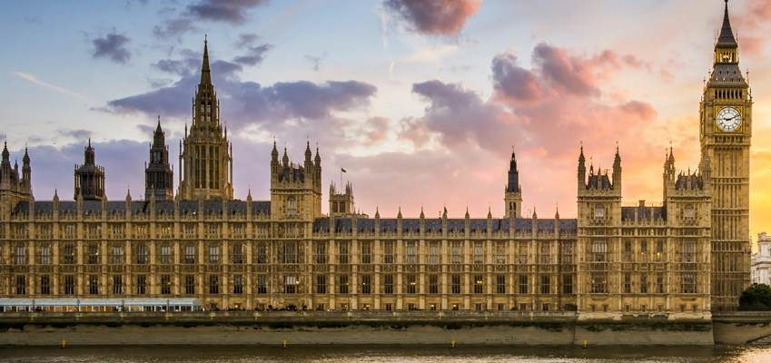
Houses of Parliament
LONDON

Slide 7
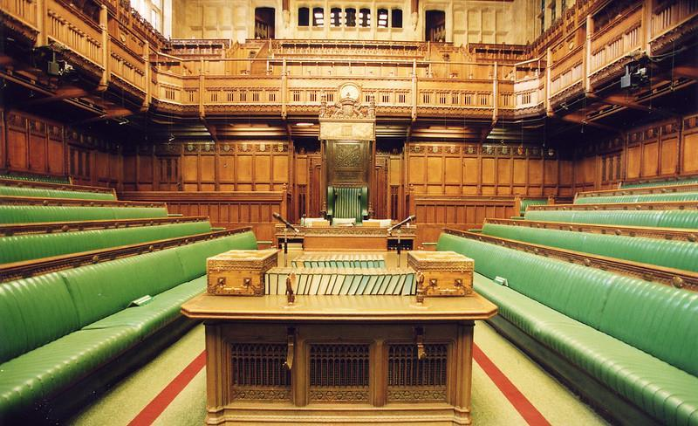
House of commons
People vote for their members of parliament by holding an election. The member of parliament (MPs) represent their people.

Slide 8
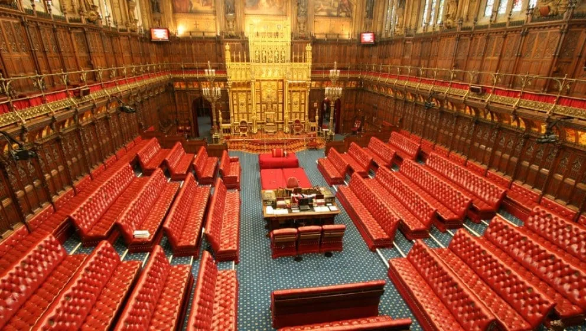
House of Lords
Chosen for their knowledge and expertise.
Debate and check the laws proposed by the House of Commons

Slide 9

What are some of the rules we have here at Meadlands?

Slide 10

What if there were no rules?

Slide 11
What if there were no rules?
Would school life be fair?

Slide 12
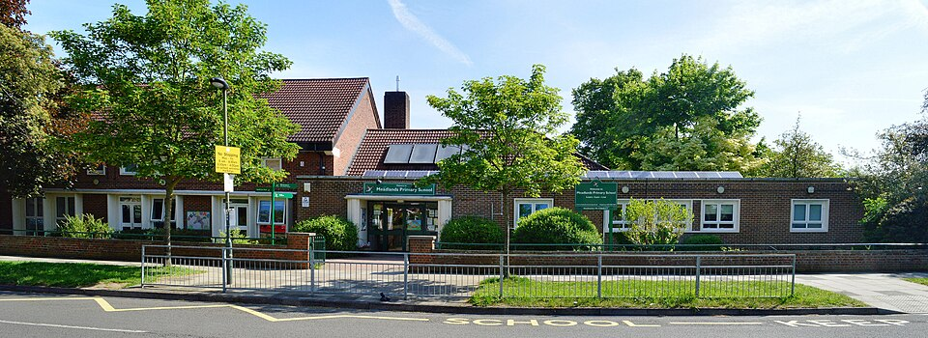
Rules
at Meadlands

Slide 13

WORK HARD
AND
BE KIND

Slide 14
At Meadlands, rules help to make things fair for everybody and keep us all safe.

