Slide 1
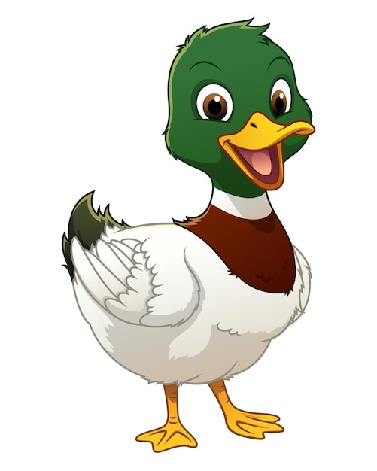
What are British Values?

Slide 2
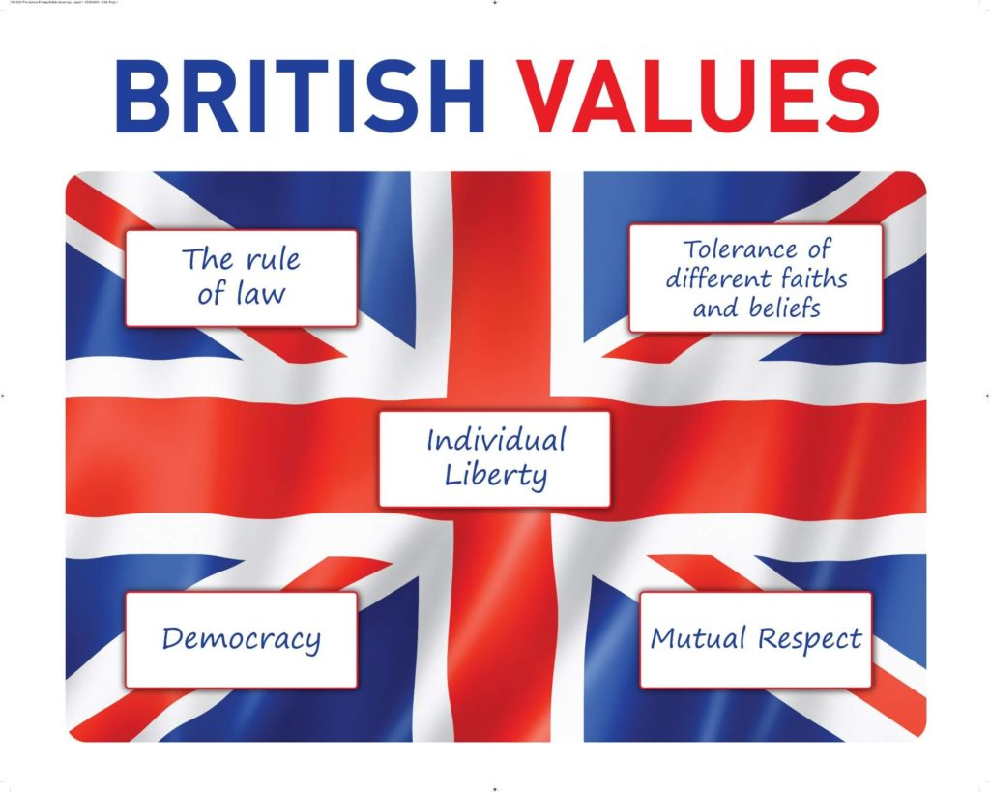

Slide 3
Root awakenings
democracy
dem comes from Greek and means “people”
cracy comes from Latin and means “rule by”
So, what does “democracy” mean?

Slide 4

democracy
Rule by the people
Everyone gets a say
In a democracy, people share ideas and vote on decisions for the group.
It helps keep things fair
Not just one person decides - many voices help choose what happens.

Slide 5
Year 6 – can you tell me what the opposite of a democracy is?
dictatorship

Slide 6
democracy
Rule by the people
Why is this important?

Slide 7
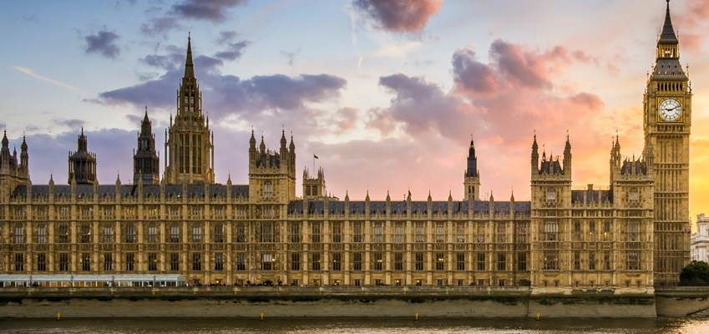
Houses of Parliament
LONDON

Slide 8
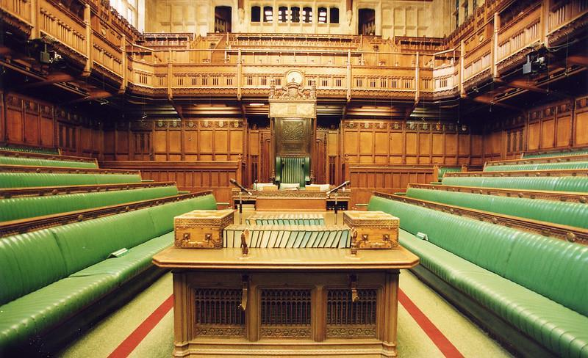
House of commons
People vote for their members of parliament by holding an election. The member of parliament (MPs) represent their people.

Slide 9
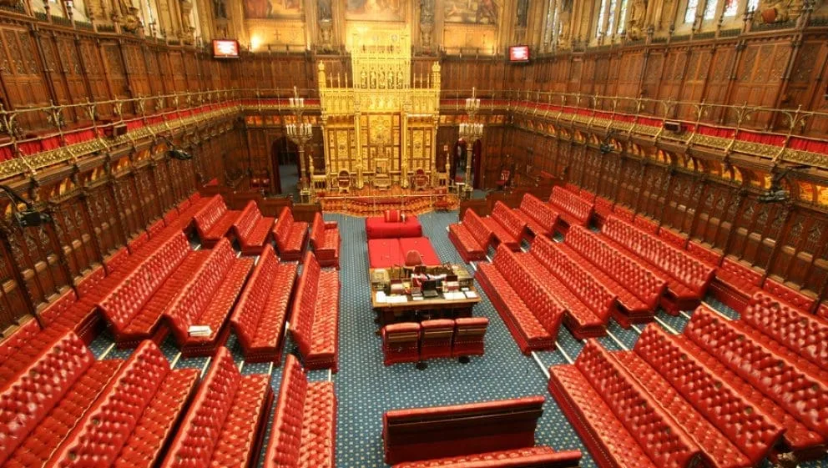
House of Lords
Chosen for their knowledge and expertise.
Debate and check the laws proposed by the House of Commons

Slide 10
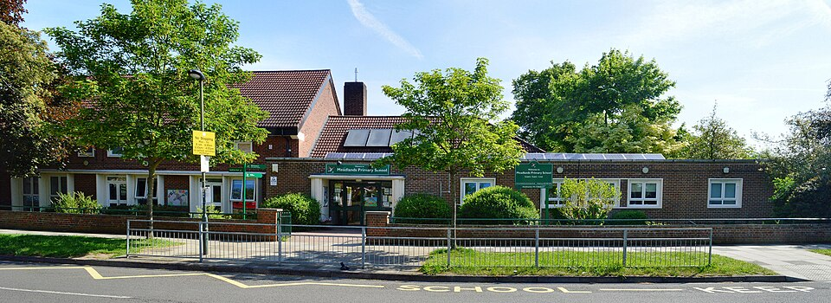
democracy
at Meadlands

Slide 11
democracy
Rule by the people
How are we democratic at Meadlands?

Slide 12
Class Behaviour Agreement

Slide 13
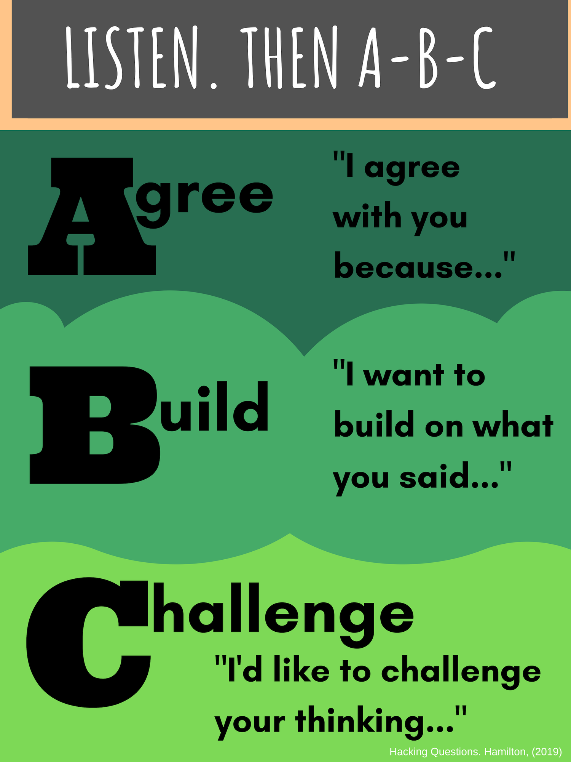

Slide 14
Voting
House Captains
Poetry Slam finalists
Charities

Slide 15
Children’s Choice Assemblies

Slide 16
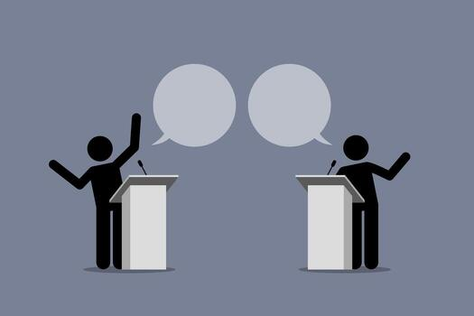
Debate Club

Slide 17
At Meadlands, everybody’s voice matters.
We are democratic

