Slide 1

Something very important is coming back to Meadlands this week…

Slide 2

Can you guess what it might be?

Slide 3

Week

Slide 4
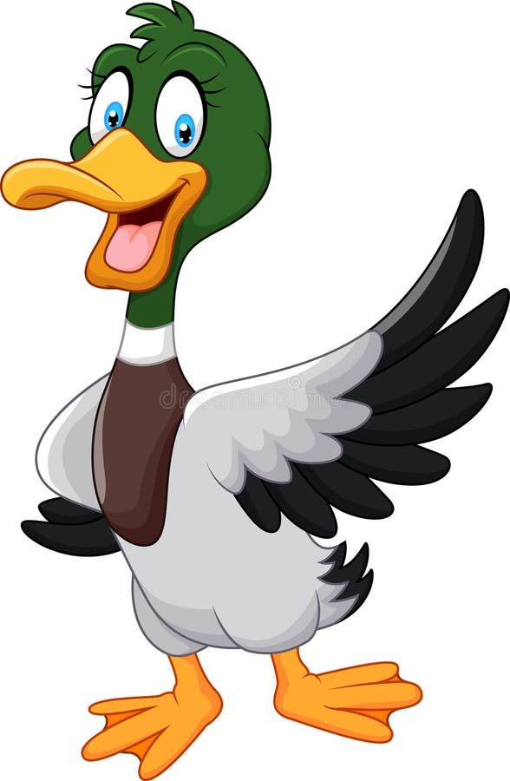
Can you remember what that means?

Slide 5
We’re going to continue to learn about why too much screen time is not good for us.

Slide 6
Did anyone reduce their screen time the last time we did this?

Slide 7
And did you keep this up?

Slide 8

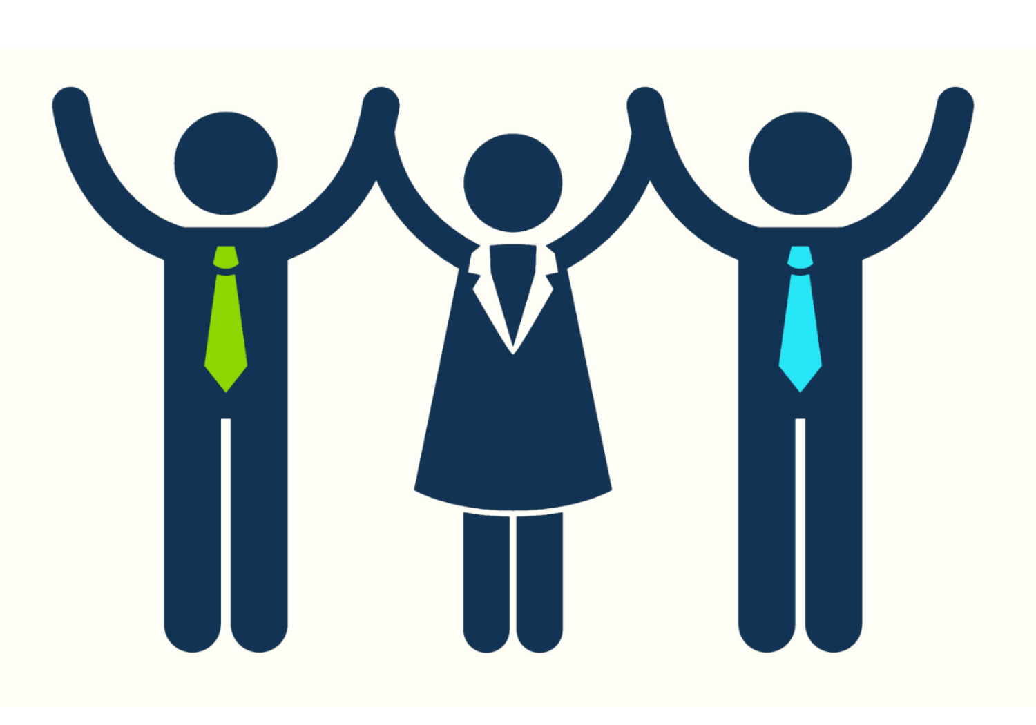
Learning about how we can control our screen time is an important life skill and will empower you!

Slide 9
Why might it be a good idea to reduce our screen time?
What could we do instead?
What advice would you give someone else who is on the screen too much?
Advice to get off the Device

Slide 10
So, it’s the second Disconnect to Reconnect Week. We will also call this
“Look Up, Take Control”

Slide 11
We want to spread this message far and wide. We are going to TAKE CONTROL!
Advice to get off the Device

Slide 12
Good Luck!

