Slide 1

Something very important is coming to Meadlands this week…

Slide 2
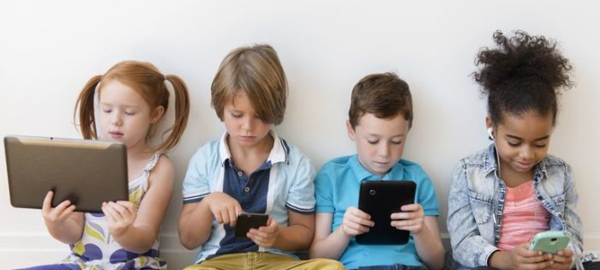
Can you guess what it might be?

Slide 3

Week

Slide 4
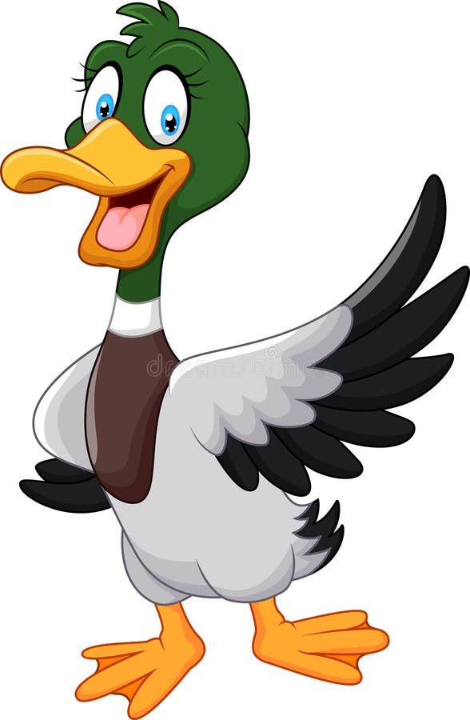
What does that really mean?

Slide 5
We’re going to attempt to reduce our screen time this week but also learn about why too much screen time is not good for us.

Slide 6


Learning about how we can control our screen time is an important life skill and will empower you!

Slide 7
Why might it be a good idea to reduce our screen time?
What could we do instead?

Slide 8
Let’s all try to reduce our screen time a bit this week and do something else. We can then talk about how it felt.

Slide 9
Good Luck!

